Slide 1
UECS1013 Introduction to Computer Organisation and Architecture
2018/Lecture 1

Slide 2
Consultation
Dr Madhavan Nair
HOD DIECS
Level 8, Room FE35 Zone 1
Email : madhavan@utar.edu.my
Consultation
  Tuesday, Thursday 9am -11am
  Any other day/time by appointment

Slide 3
Objectives
Explain functions of the central processing unit and memory
Identify the different computer peripherals and explain how they work
Explain computer operations at the digital logic level
Demonstrate assembly language coding for given instructions set

Slide 4
Assessment
No | Method of Assessment | Total
1 | Coursework Quiz 1 ( 10%) Week 4 Quiz 2 ( 10%) Week 13 Midterm Test ( 20% ) Week 10 | 40%
2 | Final Examination | 60%
No | Reference Text
1 | Main Reference(s): Stallings, W. (2015). Computer organization and architecture: Designing for performance. 10th ed. Boston: Pearson
2 | Patterson, D. A. and Hennessy, J. L. (2014). Computer organization and design: the hardware/software interface. 5th ed. Oxford: Morgan Kaufmann
3 | Englander, I. (2010). The architecture of computer hardware, systems software and networking. 4th ed. New York: Wiley.

Slide 5
Pop Quiz
Convert the following numbers to base 10.
10001₂
12₃
75₈
AE₁₆

Slide 6
INTRODUCTION
  History of Computers
  What is a Computer?
  Multi-level Computer Units
  Types of Computer
Functional Units
  Memory
  Input and Output Unit
  CPU
  Bus
Basic Operational Concepts

Slide 7
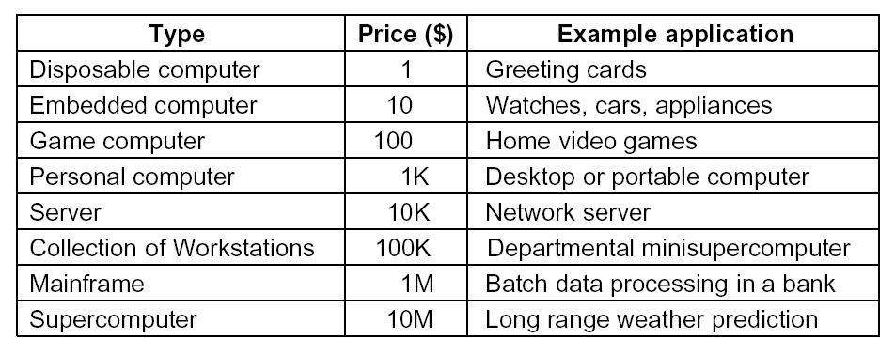
What is a Computer?
In general, a computer is a machine that can solve problems for people by carrying out instructions given to it.

Slide 8
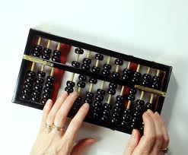
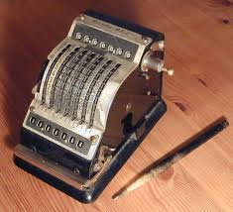
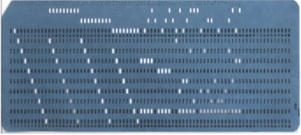
History of Computers
Mechanical Computers
Abacus invented in Babylonia in 3000BC
Adding machine by Blaise Pascal (1642)
IBM first electromechanical computer (using relays) designed by Howard Aiken (1937) was based on punched cards. It was used to calculate tables of mathematical functions.
Holes on punched card were mechanically sensed and used to control the automatic sequencing of a list of calculations

Slide 9
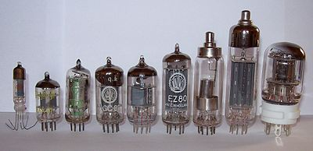
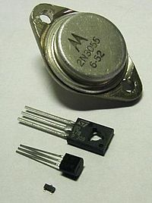
History of Computers
1st Generation Computers (1940s to early 1950s) – based on vacuum tubes technology.
  1943 – ENIAC: first fully electronic computer, designed by John Mauchly (100 to 1000 times faster than mechanical computers)
  1946 – EDVAC: first stored program computers, designed by John von Neumann
  Magnetic core memories were developed
  Magnetic tape storage devices were developed
  Programmes were written in assembly language
2nd Generation Computers (late 50s to early 60s) – based on transistors (solid state) technology.
  more reliable, less expensive, low heat dissipation
  IBM 7000 series, DEC PDP-1.
  Magnetic core memories were prominent.
  Magnetic disk storage devices were developed
  High-level languages such as Fortran were developed. Compilers were used to translate high-level languages to assembly languages

Slide 10
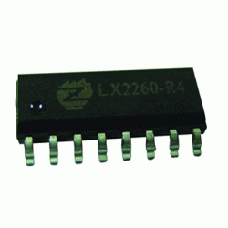
History of Computers
3rd Generation Computers (late 60s to early 80s) – integrated circuits (IC).
  Texas Instrument and Fairchild Semiconductor developed the capability to fabricate many transistor on a single silicon chip, called integrated circuits (IC)
  IBM 360 series, DEC PDP-8
  Many transistors packed into single container → low prices, high packing density
  Introduction to pipelining (multiple instructions at the same time), cache (memory appear faster) and virtual memory (memory appears bigger)

Slide 11
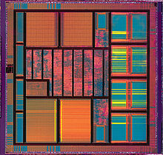
History of Computers
4th Generation Computers - Very Large Scale Integration (VLSI)
  Advances in processing/manufacturing technology → tens of thousands of transistors could be placed on a single chip → small size, low-cost, large memory, ultra-fast PCs to supercomputers
  Driving force: Intel, National Semiconductor, Motorola, Texas Instrument and Advanced Micro Devices
  Embedded computer systems and portable notebooks become widespread
  Supercomputers and grid computers emerges as the upper end computing systems for weather forecasting, scientific and engineering computations and simulations
5th Generation Computers (Parallel Computing)
  Multi-core processors
  Massively parallel, Cloud/Grid Computing, etc.

Slide 12
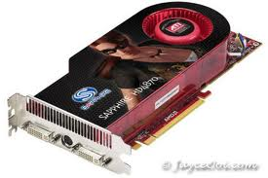
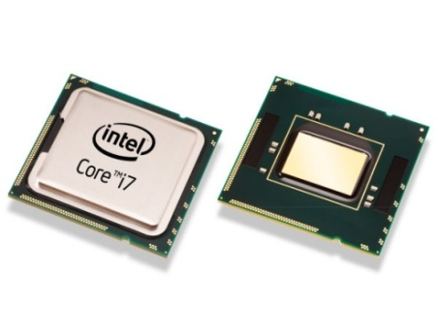
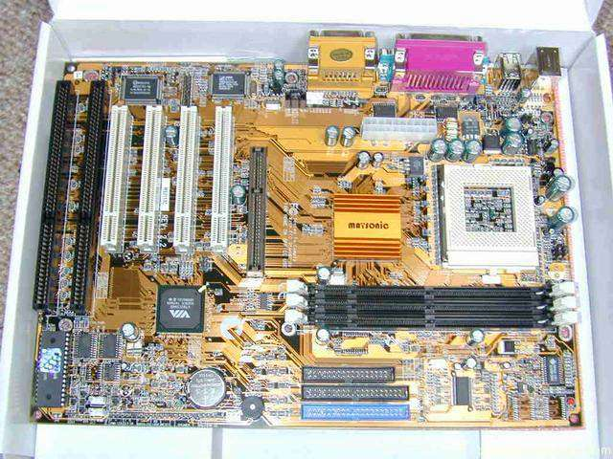
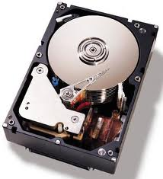
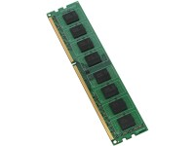
What is a Computer?
But putting together these hardware does not mean it will work automatically! You need software to manage them....
Graphics adapter
Processor
+
+
Motherboard
(Bus and I/O)
= Computer hardware
+
+
Secondary storage
Memory

Slide 13
What is a Computer?
Computer = Hardware + Software.
  Hardware: physical components for computation/processing; should be simple, fast, reliable.
  Software: set of instructions to perform tasks to specifications; should be flexible, user-friendly, sophisticated.
Computers are information processors
  Data Units:
  The hardware components of a computer system represent information as 0 (as 0V) or 1 (as either 1.8V or 3.3V or 5V).
  Therefore, data must be represented using binary digits consisting of only 0 and 1.
    1 bit (binary digit): one of two values (0 or 1)
    1 byte: 8-bits
    1 word: 1, 2, or 4 bytes, or more (depends on ALU)
Raw data
Computer system
Processed information

Slide 14
Multi-level Architecture
  Software
Applications
  High-level abstraction
  Closer to a human understanding of the problem
  Easier to program. Do not require much understanding of the computer hardware
High level languages
Assembly Language
Machine Language
Operating System
  Low-level implementation
  Closer to how the machine solves the problem.
  Difficult to program. Requires in-depth knowledge of the computer hardware
Instruction Set Architecture
Micro-architecture
  Actual physical implementation
Digital Logic

Slide 15
Multi-level Architecture
There is a large gap between what is convenient for people (the code can be understood and written easily by a human) and what is convenient for computers (code is in binary form).
Abstraction implies that any layer can hide the details of the layers below it from the layers above it.
For example, Instruction Set Architecture (ISA) is the abstraction layer between hardware and low level software layer.
Programmers are only interested in the top level but people interested in understanding how a computer really works must study all the levels.
Applications
High level languages
Assembly Language
Machine Language
Operating System
Instruction Set Architecture
Micro-architecture
Digital Logic

Slide 16
High Level Languages
For a software developer to develop applications such as a library catalogue system, Office, Winzip, game, etc.
Examples of high level languages:
  C++, Matlab, Java, Java Script, etc.
High level languages are much easier for human to understand than assembly language program and are designed to be used by application programmers with problems to solve.
Example C++ code for C= A + B
  int A, B, C; // variable declaration
  …
  C = A + B; // add operation
Programs are generally translated to lower levels by compilers.
Applications
High level languages
Assembly Language
Machine Language
Operating System
Instruction Set Architecture
Micro-architecture
Digital Logic

Slide 17
Assembly Language Level
For computer engineers to develop the software to control the operations of a system, e.g., walkie talkie, routers, etc.
A symbolic form for the underlying language. The language is specific to the hardware. Example: ARM/MIPS
Assembly language (low level language) programs are usually easier to create than machine language program but still requires an in-depth knowledge of the computer architecture (hardware resources).
Example code for C = A + B
…
LDR R0, A ; Load A into register R0
LDR R1, B ; Load B into register R1
ADD R2, R1, R0 ; Add R0 and R1 and save result to R2
STR R0, C ; Save the result into C
An assembler translates programs written in an assembly language into a sequence of machine instructions.
Applications
High level languages
Assembly Language
Machine Language
Operating System
Instruction Set Architecture
Micro-architecture
Digital Logic

Slide 18
Machine Language Level
Native codes for the machine, consisting of strings of 1's and 0's and stored as binary numbers.
The very lowest possible level at which you can program a computer. Difficult for a human programmer to program but useful for debugging purposes.
Specific to the hardware: the machine language code assembled for Intel x86 system cannot run on a ARM platform
Example machine to add two variables (C=A+B)
Applications
High level languages
Assembly Language
Machine Language
Operating System
C++ Assembly Machine Language
int A, B, C; … …
… LDR R1, A E59F1010
C = A+B; LDR R0, B E59F0008
ADD R2, R1, R0 E0812000
STR R5, C E58F5008
Instruction Set Architecture
Micro-architecture
Digital Logic

Slide 19
Operating System Level
A series of programs serves as a kind of protective shell or buffer to serve users and application programs from the complexities of the hardware.
Operating system is a resource manager:
  Manages all resources
  Decides between conflicting requests for efficient and fair resource usage (memory or CPU time)
  Control shared resources so that different users are given fair share
Operating system is a control program
  Controls execution of programs to prevent errors and improper use of the computer
  Protect the system from incorrect or malicious program and users
Applications
High level languages
Assembly Language
Machine Language
Operating System
Instruction Set Architecture
Micro-architecture
Digital Logic

Slide 20
Instruction Set Level
  The set of all instructions that is visible and available to a system-level programmer to control the operations of a PC.
  The instructions are specific for a particular hardware. Example: The instruction set for ARM is different from MC68000 system.
  The abstraction layer between the actual hardware and the low-level software.
  May be carried out interpretively either by the microprogram or hardware at the micro-architecture level.
  Example instructions:
    ADD Rx, Ry
    LDR, Rx, Ry
Applications
High level languages
Assembly Language
Machine Language
Operating System
Instruction Set Architecture
Micro-architecture
Digital Logic

Slide 21
Microarchitecture Level
At this level, registers are connected to the ALU to form a data path, over which the data flow.
The operation of the data path (from registers to ALU) is controlled directly by a program called a microprogram or directly by hardware.
A microprogram is an interpreter for the instructions at ISA:
  e.g., ADD
      fetch instruction
      locate operands and bring into registers
      compute sum by the ALU
Applications
High level languages
Assembly Language
Machine Language
Operating System
Instruction Set Architecture
Micro-architecture
Digital Logic

Slide 22
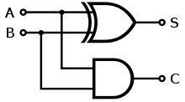
Digital Logic Level
The basic building block of a digital logic is gate.
Example: How are the adder which adds two binary digits being implemented at the hardware (gate) level?
Each gate has one or more digital inputs (signals representing 0 or 1) and computes as output some simple functions of these inputs, e.g., AND or OR.
Gates can form the main computing engine. Gates can also form a 1-bit memory; some 1-bit memories can form registers for holding binary numbers.
Covered in UECS1013
Applications
High level languages
Assembly Language
Machine Language
Operating System
Instruction Set Architecture
Micro-architecture
Digital Logic

Slide 23
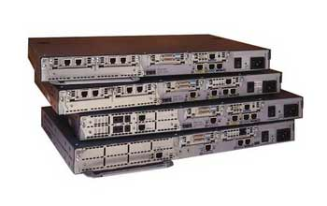
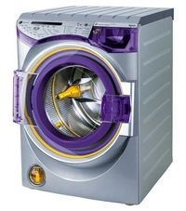
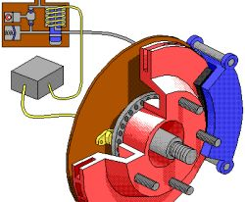
Computer Types
Embedded Computers
  Integrated into a larger system to automatically monitor and control a physical process .
  Used for specific purpose rather than for general tasks.
  Typical applications: industrial and home automation, appliances, telecommunication products and vehicles.
  Examples:
Routers
Washing machines
ABS Braking System

Slide 24
Computer Types
Personal Computers
  Unlike Embedded Computers, personal computers are general-purpose – could be used to perform a variety of tasks
  Used at different settings (homes, educational institution, business and engineering departments) and can be installed with a variety of application
Servers and Enterprise Systems
  Large computers that are shared by large number of users
  Each user can be a personal computer over a public or private network.
  Example: database & information processing for government

Slide 25
Computer Types
Supercomputer
  Used for highly demanding computations, e.g., weather forecasting, engineering design and simulation, etc.
  Offering the highest performance
  Most expensive and physically the largest
Year | Supercomputer | Peak speed (Rmax) | Location
2008 | IBM Roadrunner | 1.026 PFLOPS | Los Alamos, USA
 |  | 1.105 PFLOPS
2009 | Cray Jaguar | 1.759 PFLOPS | Oak Ridge, USA
2010 | Tianhe-IA | 2.566 PFLOPS | Tianjin, China
2011 | Fujitsu K computer | 10.51 PFLOPS | Kobe, Japan
2012 | IBM Sequoia | 16.32 PFLOPS | Livermore, USA
2012 | Cray Titan | 17.59 PFLOPS | Oak Ridge, USA
2013 | NUDT Tianhe-2 | 33.86 PFLOPS | Guangzhou, China
Source: Wikipedia
Source: Wikipedia

Slide 26
Computer Types
Grid Computing
  More cost effective than super computer
  Links a large number of disparate personal computers and disk storage units in a physically distributed high-speed network (grid)
  Grid computing relies on software (middleware) to divides/directs pieces of a program to a number of different computers.
  Allows remote access to computing resources
  Computing power is aggregated but with communication overhead
Cloud Computing
  Built upon the foundation of Grid Computing
  Further offers on-demand resource provisioning. Allows companies immediate access to high computational power without having into developing new infrastructure by outsourcing

Slide 27
Computer Types
Cloud Computing (…cont)
  Providers can provide cloud services as 3 different services
  Infrastucture as a Service (IaaS)
    Cloud provider supplies the physical or virtual machines, raw storage, load balancers and network from their large pool of computing equipments installed in data centers.
    Customer install their operating system images & software on the machines before deploying their application.
  b) Platform as a Service (PaaS)
    Cloud provider supplies the platform (operating system, programming language environment and web server)
    Customer develops software solutions on the cloud platform (do not need to invest in infrastructure to start)
  c) Software as a Service (SaaS)
    Cloud provides and installs the application software
    Customer to run the computational expensive application in the cloud network to enjoy the desired high performance

Slide 28
Functional Units
Arithmetic Logic Unit (ALU)
Memory
Input
Control Unit (CU)
Output
Bus
Registers
Central Processing Unit (CPU)
I/O
CPU Components:
  CPU: performs mathematical & logical operations, controls operations of a computer).
  Memory: stores programs and intermediate data.
  Input Devices: accept data from outside world.
  Output Devices: presents data to the outside world.
  Bus: communication between the components
An analogy with Human Information Processors:
  CPU – brain’s reasoning powers
  Memory – brain’s memory
  Input Devices – eyes, ears, sensory sub-system
  Output Devices – mouth, hands, facial and body expressions
  Bus – nerves

Slide 29
Memory
Primary Memory (Main Memory)
All programs and their data must be hold in this memory while they are being executed
Constructed from semiconductor bit cells, each capable of storing one bit.
Memory are typically accessed in groups of fixed size called words. The number of bits in each word is called word length and is typically 16, 32 or 64 bits.
Primary memory is typically RAM
Memory access time: time to access one word.
Random-access memory (RAM): memory where the access time is short and fixed regardless of its location
CDROM
Arithmetic Logic Unit (ALU)
Memory
Hard Disk
Control Unit (CU)
Output
Bus
Registers
I/O
Central Processing Unit (CPU)
Cache
An adjunct to the main memory, fabricated on the processor chip
Much smaller and faster than the main memory
Holds only part of the program and data currently being executed by the processor

Slide 30
Memory
Register
Fastest memory in the system
Used to store the data that is currently being executed
Secondary Storage
Primary memory is expensive and is volatile (does not retain the content when power is turned off)
Secondary storage is a non-volatile memory that is used to store large amounts of data and programs. Example: magnetic disks, optical disks, flash memory devices
A magnetic disk can store 500 or more Gigabytes
CDROM
Arithmetic Logic Unit (ALU)
Memory
Hard Disk
Control Unit (CU)
Output
Bus
Registers
I/O
Central Processing Unit (CPU)
Fast, expensive (small numbers), volatile
registers
main memory
disk storage
magnetic tapes
Slow, cheap (large numbers), non-volatile

Slide 31
Input and Output Unit
Arithmetic Logic Unit (ALU)
Input Units
Computer accepts coded information through input units
Provides human-computer interaction: keyboards, mouse, touch screen
Provides digital communication facilities such as Internet to allow computers to communicate
Provides data transfer for secondary storage devices: hard disk (file transfer or load a program into memory), microphone (capture, audio input to be sampled and converted into digital codes for storage)
Memory
Input
Control Unit (CU)
Output
Bus
Registers
I/O
Central Processing Unit (CPU)
Output Units
Counterpart of the input units. Used to send processed results to the outside world
Example: printer, monitor, graphic display, etc.
Some units performs both functions of input and output, e.g., touch screen, network card, etc.

Slide 32
Central Processing Unit (CPU)
Execute programs (a set of instructions to accomplish a certain task) that are stored in the main memory by fetching and then executing them one after another.
Arithmetic Logic Unit (ALU)
Memory
Input
Control Unit (CU)
Output
Bus
Registers
I/O
Central Processing Unit (CPU)
Arithmetic Logical Unit (ALU)
  Performs arithmetic and logical operations such as addition, subtraction, multiplication, comparison of numbers, etc.
  These operations is initiated by bringing the required operands into the processor, where the operation is performed by the ALU
  For example, when adding two numbers in the memory, these two numbers are first be brought into the processor before addition is carried out by ALU.
  The sum may then be stored in the memory or retained in the CPU (register) for immediate use.
Registers are high speed memory used to temporarily store the variables in an instruction currently executed by the CPU.
Notes:
PC points to the next instruction to be fetched for execution
IR holds the instruction currently being executed

Slide 33
Central Processing Unit (CPU)
Execute programs (a set of instructions to accomplish a certain task) that are stored in the main memory by fetching and then executing them one after another.
Arithmetic Logic Unit (ALU)
Memory
Input
Control Unit (CU)
Output
Bus
Registers
I/O
Central Processing Unit (CPU)
Control Unit co-ordinates the operations between different units
  Control circuits are responsible for generating the timing signals and control signals that govern a particular computer operation (e.g. addition, or data transfer)
  Timing signals synchronizes the computer operation so that all steps are executed in the right sequence.
  Control signals controls the data transfer. For example, to perform REG1 + REG2, the first and the second input to the ALU is directed from REG1 and REG2, respectively and not other registers
  In reality, a control unit is not a well-defined, physical structure but is rather physically distributed throughout the computer.
Notes:
PC points to the next instruction to be fetched for execution
IR holds the instruction currently being executed

Slide 34
Bus
Buses are communication links allowing data, instructions and memory addresses to be referenced between different components (CPU, main memory and I/O devices) in a computer system.
A bus is a group of lines such that a word of data can be transferred (one bit per line) at a time.
Bus arbiter (not shown in the diagram) is controller that decides which requesting device is granted access to the bus when multiple devices share the same bus.
Arithmetic Logic Unit (ALU)
Memory
Input
Control Unit (CU)
Output
Bus
Registers
I/O
Central Processing Unit (CPU)

Slide 35
Basic Operational Concepts
An instruction specifies an operation and its data operands. For example, the instruction ADD R4, R3, R2 for the ARMS processor adds the content of R3 and R2 and stores the result in R4.
The basic instructions type are:
A program is a sequence of instructions, executed one after another, to perform a particular task.
All programs and its data needs to be stored in the main memory before it can be executed.
Load Read a data operand from memory or an input device
into the CPU
Store Write a data operand from a CPU register to memory or
an output device
Operate Perform an arithmetic or logic operation on data
operands in CPU registers
Flow Control the execution flow (if-else and while statements)

Slide 36
Basic Operational Concepts
Sample program for the ARM processor:
Write a program to perform the following operation:
C = A + B
A, B, and C, are labels representing memory word addresses;
Ri are processor registers
LDR R2, A ; Load A into CPU register 2
LDR R3, B ; Load B into CPU register 3
ADD R4, R2, R3 ; Add register 3 and 2 and save into register 4
STR R4, C ; Store result into memory location C

Slide 37
Basic Operational Concepts
Program (exe)
LDR R2, A
LDR R3, B
ADD R4, R2, R4
STR R4, C
Arithmetic Logic Unit (ALU)
B
C
Control Unit (CU)
Program (exe)
LDR R2, A
LDR R3, B
ADD R4, R2, R4
STR R4, C
A
Memory
Registers
1
2
3
Bus
Hard Disk
Central Processing Unit (CPU)
The basic operation of a Computer:
(1) Load:
Program (instruction+data) is loaded from storage unit into memory.
(2) Fetch:
By default, CPU fetches the instructions (of the program) from the memory line by line sequentially. The control unit decodes the instruction to identify the instruction (load) with its field (A and R2)
(3) Execute:
Each instruction line is executed by CPU.
4

Slide 38
NUMBER SYSTEM
  Positional Notation Number System
    Decimal Number (Base 10)
    Binary (Base 2)
    Octal (Base 8)
    Hexadecimal (Base 16)
    Conversion from other Bases to Base 10
    Range of a Number System (Integers)
    Fractions

Slide 39
Positional Notation Number System
  Number System: a mathematical notation used to represent numbers of a given set by using symbols in a consistent manner.
  Position Independent Number Systems: a number system where the number of digits representing a number does not reflect the true value of the number.
  Example : Roman: I, II, III, IV, V, ….
  Positional Notation Number Systems defines a finite set of numeric symbols/digits and then use multiple digits to represent numbers that are larger than the number of symbols.
  Example: Decimal: 1, 2, 3, 4, …, 10, 11, …., 99, 100, …
For these systems, the Base of a number system represents the number of digits that are defined:
  Binary (Base 2): 0, 1
  Octal (Base 8): 0, 1, 2, 3, 4, 5, 6, 7
  Decimal (Base 10): 0, 1, 2, 3, 4, 5, 6, 7, 8, 9
  Hexadecimal (base 16): 0, 1, 2, 3, 4, 5, 7, 8, 9, A, B, C, D, E, F

Slide 40
Positional Notation Number System
  Why do we focus on binary, octal, decimal and hexadecimal number system whereas we can also have Base 3, Base 5, Base 6, …?
  Human are familiar with Base 10 (Decimal) number system
    Base 10 uses 10 digits (0, 1, 2, …9) to represent numbers
    Origin: counting on the fingers
    “Digit” from the Latin word digitus meaning “finger”
  A computer “has only two fingers” and therefore it operates in the Base 2 (Binary) number system.
      The input to the logic gates contains only two possible values. The elementary storage units inside computer are electronic switches. Each switch holds one of two states: on (1) or off (0).
      Base 2 uses a bit (two binary digit), 0 or 1, to represent numbers
    Base 8 (Octal) or Base 16 (Hexadecimal) falls within the same family (power of two) and can be converted easily.
ON
OFF

Slide 41
Positional Notation Number System
    To represent a value larger than the total number of digits in a number system, we can use multiple digits.
      For example, the number twelve cannot be represented using a single decimal digit (ten valid symbols only), and we have to use two digits (12₁₀)
      For example, 1 switch in a binary system can represent 2 values and two switches can represent 4 values.
In this system, the position of the digits is assigned a certain weight based on the base value.
  Binary (Base 2): weights are in the powers-of-2.
  Octal (Base 8): weights are in the powers-of-8.
  Decimal (Base 10): weights are in the powers of 10
  Hexadecimal (base 16): weights are in the powers-of-16.
0 (00)
1 (01)
2 (10)
3 (11)

Slide 42
Positional Notation Number System
    Notations:
    To differentiate between the different bases, the subscript value following the number itself denotes the base that the number is being represented. For example
      10100₂ (in base 2), 263₇ (in base 7)
      129₁₀ (in base 10), 8AE7₁₆ (in base 16)
    The largest digit in a number must not be bigger than the base. For example, the largest digit in 10100₂ is 1 and the largest digit in 523₆ is 5.
    The same set of digits in different number system represents different numbers. For example:
    111₂ ≠ 111₈ ≠ 111₁₀ ≠ 111₁₆
    1101111₂ ≠ 157₈ = 111₁₀ = 6F₁₆
    A number is not followed by any subscript, the default base (Base 10) is assumed. For example, 124 = 124₁₀.

Slide 43
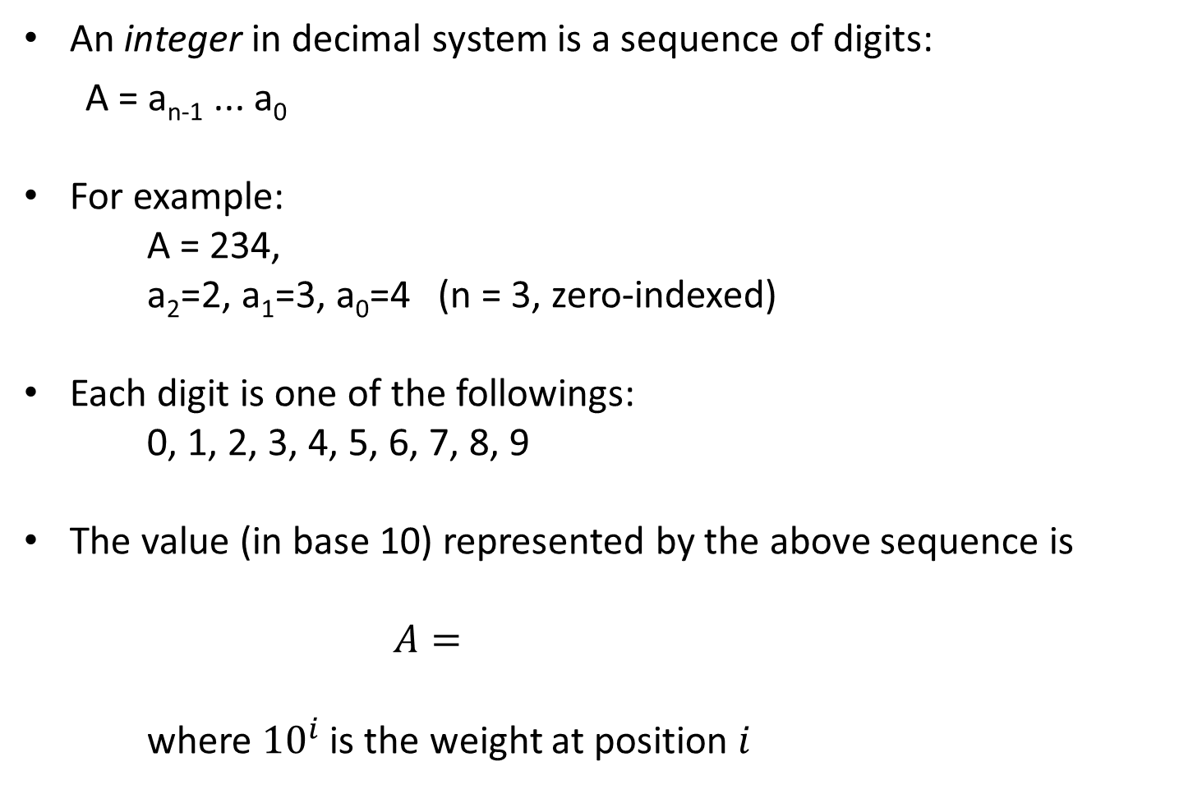
Decimal (Base 10 Integers)
An integer in decimal system is a sequence of digits:
  A = a_{n-1} ... a₀
For example:
A = 234,
a₂=2, a₁=3, a₀=4 (n = 3, zero-indexed)
Each digit is one of the followings:
  0, 1, 2, 3, 4, 5, 6, 7, 8, 9
The value (in base 10) represented by the above sequence is
$A=$
where ${10}^{i}$ is the weight at position $i$

Slide 44
Decimal (Base 10 Integers)
Examples
527₁₀
= 5 x 10² + 2 x 10¹ + 7 x 10⁰
43₁₀
= 4 x 10¹ + 3 x 10⁰
i | 2 | 1 | 0
Weight | 10² | 10¹ | 10⁰
 | 100 | 10 | 1
Value x Weight | 5 x 100 | 2 x 10 | 7 x1
Sum | 500 | 20 | 7
i | 1 | 0
Weight | 10¹ | 10⁰
 | 10 | 1
Value x Weight | 4 x 10 | 3 x1
Sum | 40 | 3

Slide 45

Binary (Base 2 Integers)
A number in binary system is a sequence of bits, possibly followed by a binary point and then a sequence of bits.
The actual value (in Base 10) represented by the binary number is:
$$A=\sum_{i=0}^{n−1}{{ a}_{i}×2^{i}}$$
1101 0110₂
= 128 + 64 + 16 + 4 + 2 = 214₁₀
i | 7 | 6 | 5 | 4 | 3 | 2 | 1 | 0
Weight | 2⁷ | 2⁶ | 2⁵ | 2⁴ | 2³ | 2² | 2¹ | 2⁰
 | 128 | 64 | 32 | 16 | 8 | 4 | 2 | 1
Value x Weight | 1x128 | 1x64 | 0x32 | 1x16 | 0x8 | 1x4 | 1x2 | 0x1
Sum for Base 10 | 128 | 64 | 0 | 16 | 0 | 4 | 2 | 0

Slide 46
Binary (Base 2 Integers)
In computer terminology,
1 Kilo (K) =
1 Mega (M) =
1 Giga (G) =
1 Tera (T) =
  Examples:
  4KB
  16MB
  2TB
2¹⁰
2²⁰
2³⁰
2⁴⁰
= 2² × 2¹⁰ = 2¹² = 4,096 bytes
= 2⁴ × 2²⁰ = 2²⁴ = 16,777,216 bytes
= 2¹ × 2⁴⁰ = 2⁴¹ = 2,199,023,255,552 bytes

Slide 47
Octal (Base 8 Integers)
The possible digits in an octal number are:
  0, 1, 2, 3, 4, 5, 6, 7
The actual value (in Base 10) represented by the octal digit sequence A_{n-1}...A₁A₀ is:
624₈
= 404₁₀
Position | 2 | 1 | 0
Weight | 8² 64 | 8¹ 8 | 8⁰ 1
Value x Weight | 6 x 64 | 2 x 8 | 4 x 1
Sum | 384 | 16 | 4

Slide 49
Hexadecimal (Base 16 Integers)
The possible digits in a hexadecimal number are:
  0, 1, 2, 3, 4, 5, 6, 7, 8, 9, A, B, C, D, E, F
  where A, B, C, D, E, F stand for 10, 11, 12, 13, 14, 15 in decimal respectively.
The actual value (in base 10) represented by the hexadecimal digit sequence A_{n-1}...A₁A₀ is:
6,704₁₆
= 26,372₁₀
Position | 3 | 2 | 1 | 0
Weight | 16³ 4,096 | 16² 256 | 16¹ 16 | 16⁰ 1
Value x Weight | 6 x 4,096 | 7 x 256 | 0 x 16 | 4 x 1
Sum | 24,576 | 1,792 | 0 | 4

Slide 50
Conversion from other bases to Base 10
Convert the following numbers to Base 10:
AEC₁₆
17₈
77₅
  10101₂
= 10x16² + 14x16¹ + 12x16⁰ = 2796₁₀
= 1x8¹ + 7x8⁰ = 15₁₀
= 7x5¹ + 7x5⁰ = 42₁₀
  = 1 × 2⁴ + 0 × 2³ + 1 × 2² + 0 × 2¹ + 1 × 2⁰
  = 21₁₀

Slide 51


Range of a Number System (Integers)
The range of a number system is how many different numbers it can represent.
The range R for K digits in Base B is:
Conversely, the number of digits K required to represent a total of R numbers in a Base B number system is:
$$R=B^{K}$$
$$K= \left\lceil \log_{B}R\right\rceil$$

Slide 52
Range of a Number System (Integers)
Example:
  How many numbers can 1 bit represent? How about 4 bits?
1 bit , base 2 → represents up to 2¹ or 2 values (0 or 1)
4 bits, base 2 → represents up to 2⁴ or 16 values (0000, 0001, 0010, …, 1111)
How many numbers can 2 digits in Base 8 represent?
2 digits , base 8 → represents up to 8² or 64values
00, 01, 02, …, 07
10, 11, 12, …, 17,
20, 21, 22, …, 27,
…
70, 71, 72, …, 77

Slide 53
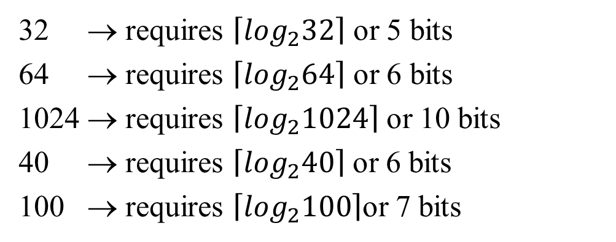
Range of a Number System (Integers)
Example:
How many bits are required to represent 32, 64, 1024, 40 and 100 values?
32 → requires $\left\lceil \log_{2}32\right\rceil$ or 5 bits
64 → requires $\left\lceil \log_{2}64\right\rceil$ or 6 bits
1024 → requires $\left\lceil \log_{2}1024\right\rceil$or 10 bits
40 → requires $\left\lceil \log_{2}40\right\rceil$or 6 bits
100 → requires $\left\lceil \log_{2}100\right\rceil$or 7 bits

Slide 54
Fractions
A number with fractional part (example 15.35₁₀ in Base 10) is a sequence of digits, followed by a decimal point or radix point in general, and then a sequence of digits:
Radix point separates the integral part (with positive powers of the base, with value ≥1 and ≤0) from the fractional part (with negative powers of the base, with 1<value<0).
  a_{n} … a₀ . a₋₁ … a_{-k}
  a_{n} : most significant digit; a_{-k} : least significant digit
For the fractional part, the successive digits have the following values
1/B, 1/B², 1/B³, 1/B⁴, …
or equivalently
B⁻¹, B⁻², B⁻³, B⁻⁴, …
where B is the base of the number

Slide 55
Fractions
= 0.671875₁₀
0.101011₂
15.35₁₀
6F.77₁₆
101.01₂
Position | -1 | -2 | -3 | -4 | -5 | -6
Weight | 2⁻¹ 1/2 | 2⁻² 1/4 | 2⁻³ 1/8 | 2⁻⁴ 1/16 | 2⁻⁵ 1/32 | 2⁻⁶ 1/64
Value x Weight | 1 x 1/2 | 0 x 1/4 | 1x 1/8 | 0 x 1/16 | 1 x 1/32 | 1 x 1/64
Sum | .5 |  | 0.125 |  | 0.03125 | 0.015625
= 1 × 10¹ + 5 × 10⁰ + 3 × 10⁻¹ + 5 × 10⁻²
= 6 × 16¹ + 15 × 16⁰ + 7 × 16⁻¹ + 7 × 16⁻²
= 111.46484375₁₀
= 1 × 2² + 1 × 2⁰ + 1 × 2⁻²
= 5.25₁₀

Slide 56
Fractions
Example:
Convert A3F.C₁₆ to decimal
A3F.C₁₆= 10 × 16² + 3 × 16¹ + 15 × 16⁰ + 12 × 16⁻¹
= 2623.75₁₀
Convert 132.7₈ to decimal
132.7₈= 1× 8² + 3× 8¹ +2 × 8⁰ + 7 × 8⁻¹
= 90.875₁₀

Slide 57
Fractions
  Example:
  0.011₂
There may NOT be an exact relationship between fractional numbers in different number base. For example:
0.1₁₀ cannot be represented exactly in binary (Base 2)
Equivalent value is 0.0001100110011…₂
0.1₃ cannot be represented exactly in decimal (Base 10)
Equivalent value 0.333333….₁₀
  = 0 × 2⁻¹ + 1 × 2⁻² + 1 × 2⁻³
  = 0.0 + 0.25 + 0.125
  = 0.375₁₀

Slide 58
Fractions
Moving the radix point one place to the right multiplies the number by the base number. Example:
  139.15₁₀ x 10¹ = 1391.5₁₀
  139.15₁₀ x 10² = 13912₁₀
  101.11₂ x 2¹ = 1011.1₂ (or equivalently 5.75₁₀ x 2₁₀ = 11.5₁₀)
  101.11₂ x 2³ = 101110₂ (or equivalently 5.75₁₀ x 8₁₀ = 46₁₀)
Move the number point one place to the left divides the number by the base number. Example:
  139.15₁₀ / 10¹ = 13.915₁₀
  139.15₁₀ / 10² = 1.3915₁₀
  101.11₂ / 2¹ = 10.111₂ (or equivalently 5.75₁₀ / 2₁₀ = 2.875₁₀)
  101.11₂ / 2³ = 0.10111₂ (or equivalently 5.75₁₀ / 8₁₀ = 0.71875₁₀)

Slide 59
Review Question
Question 1:
Convert the following value to Base 10:
FF02₁₆
776₈
1001 0110₂
Question 2:
How many numbers can be represented using
Base 10, 2 digits
Base 2, 16 digits
Question 3:
How much digits do we need to cover the unsigned value 23000 in Base 2, 10 and 16?

